Slide 1
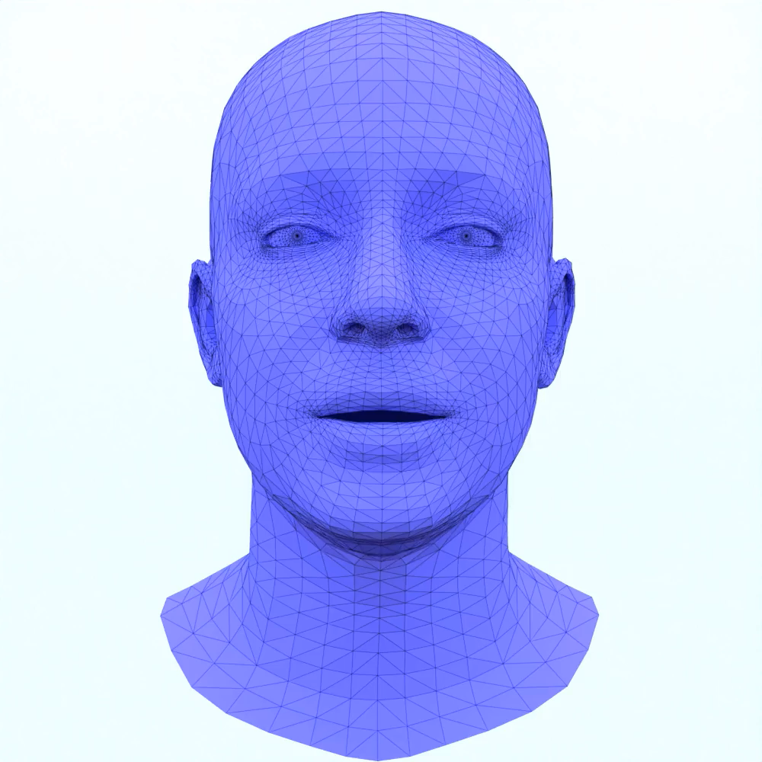
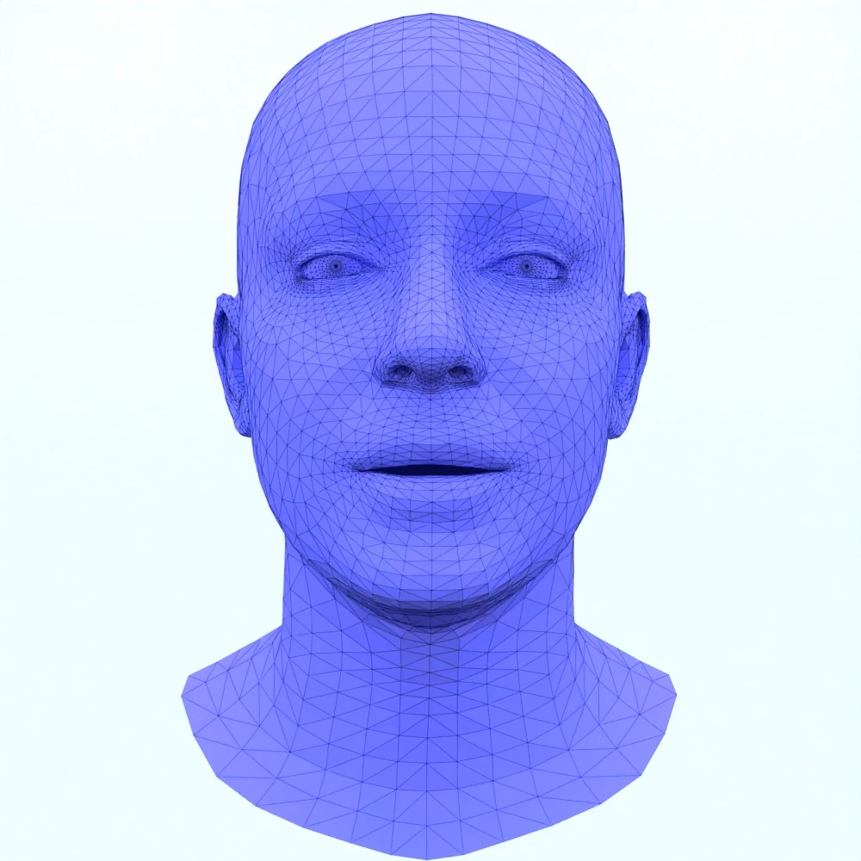
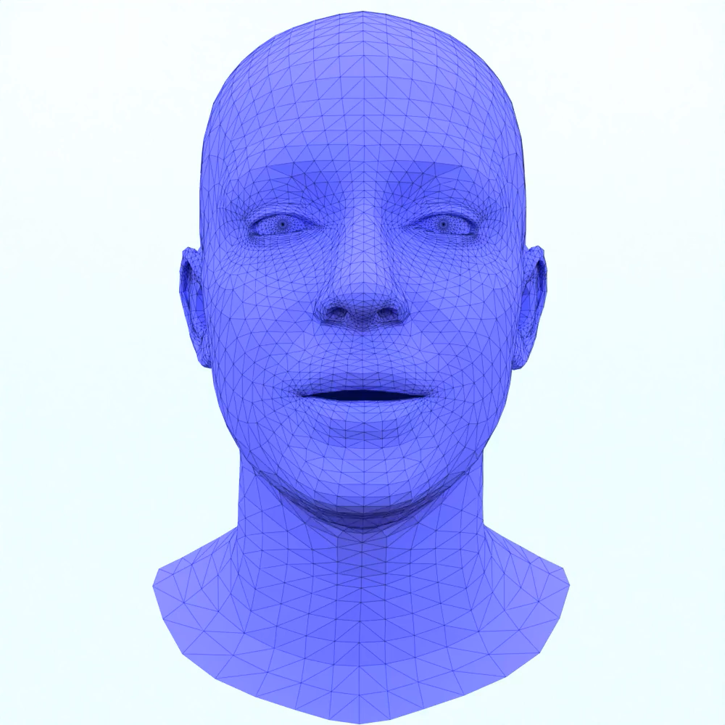
Text Guided Generation of Head Avatars
Kissing
Sneering
Weeping
Christoph Höll
Supervisor: Shivangi Aneja
Notes:
- Hello an welcome

Slide 2
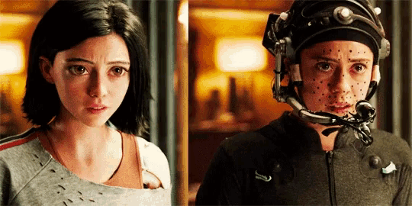
Motivation
Currently: expensive facial motion capturing
Problem: Creative restrictions
Solution:
Generate realistic 3D head & face animations from a textual input
Motion Capturing
https://tenor.com/de/view/alita-behind-the-scenes-cgi-gif-13549391
Notes:
- modern film productions & game dev: motion capturing / handcrafted
- Very expensive & impossible for smaller studios
- Solution: advances in generative models -> generate realistic 3D face animations from description

Slide 3
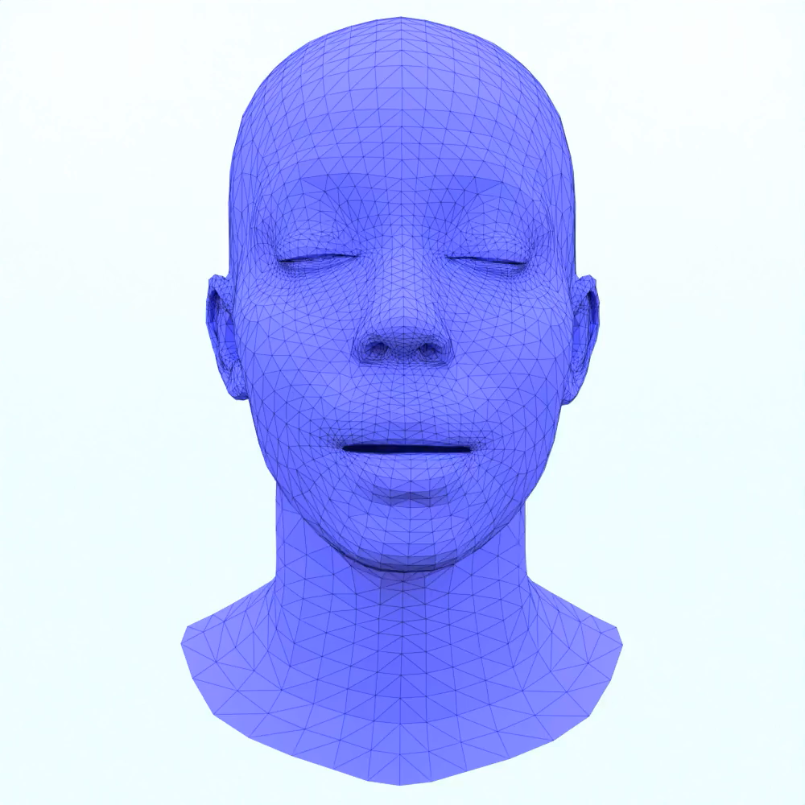
Problem Statement
Goal: Generate realistic 3D head & face animations from a textual description
Our Method
A Person is talking while blinking
Notes:
This is the task we decided to solve as part of this thesis
From description like
To an animation

Slide 4
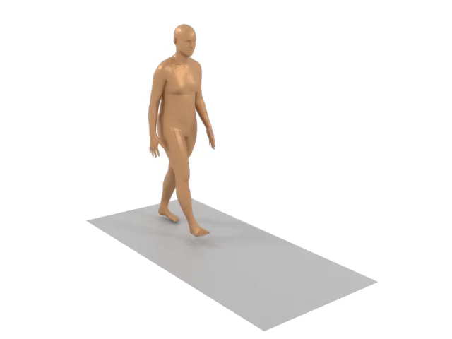
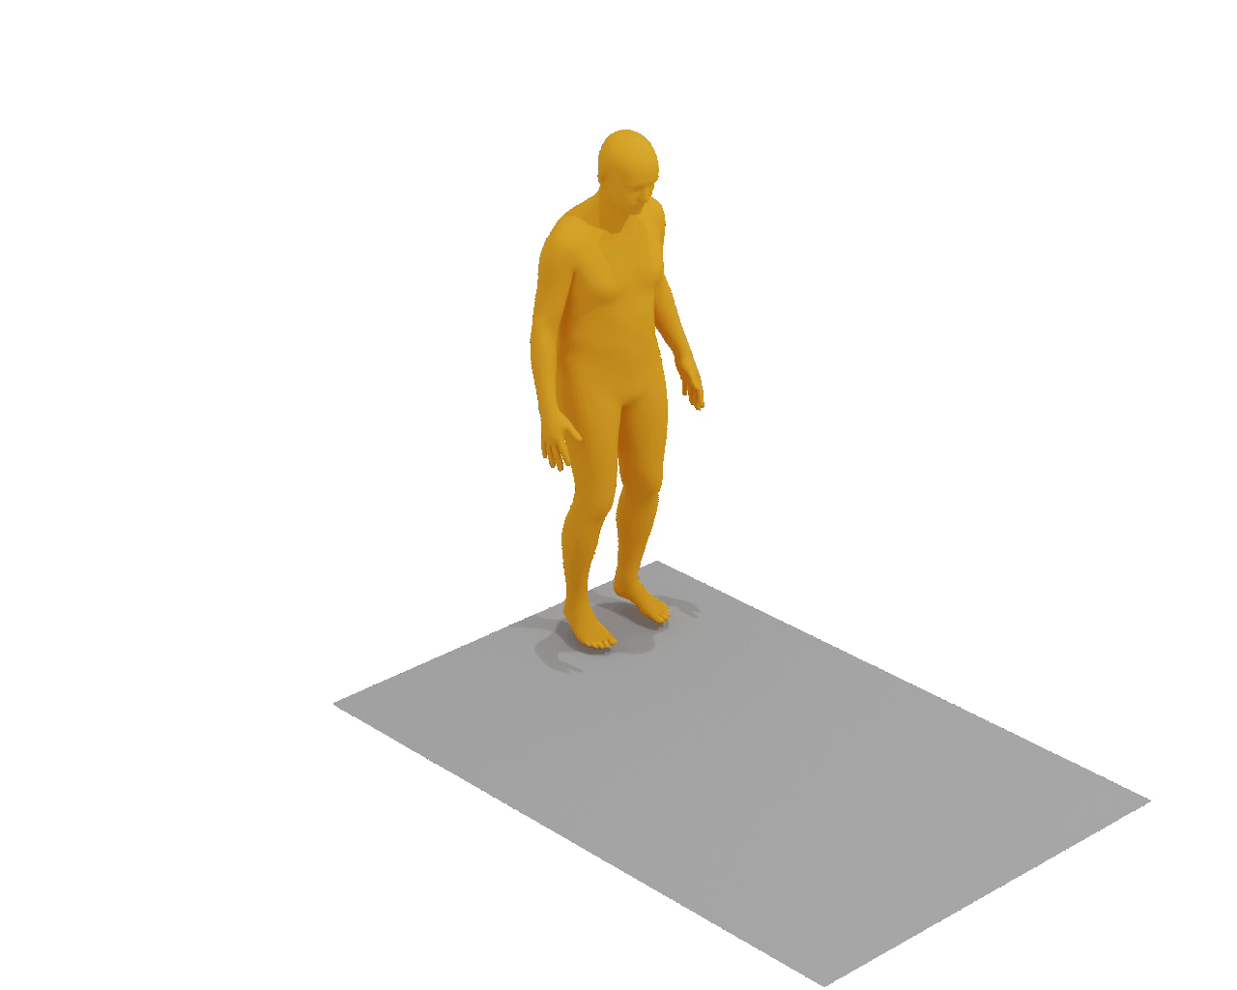
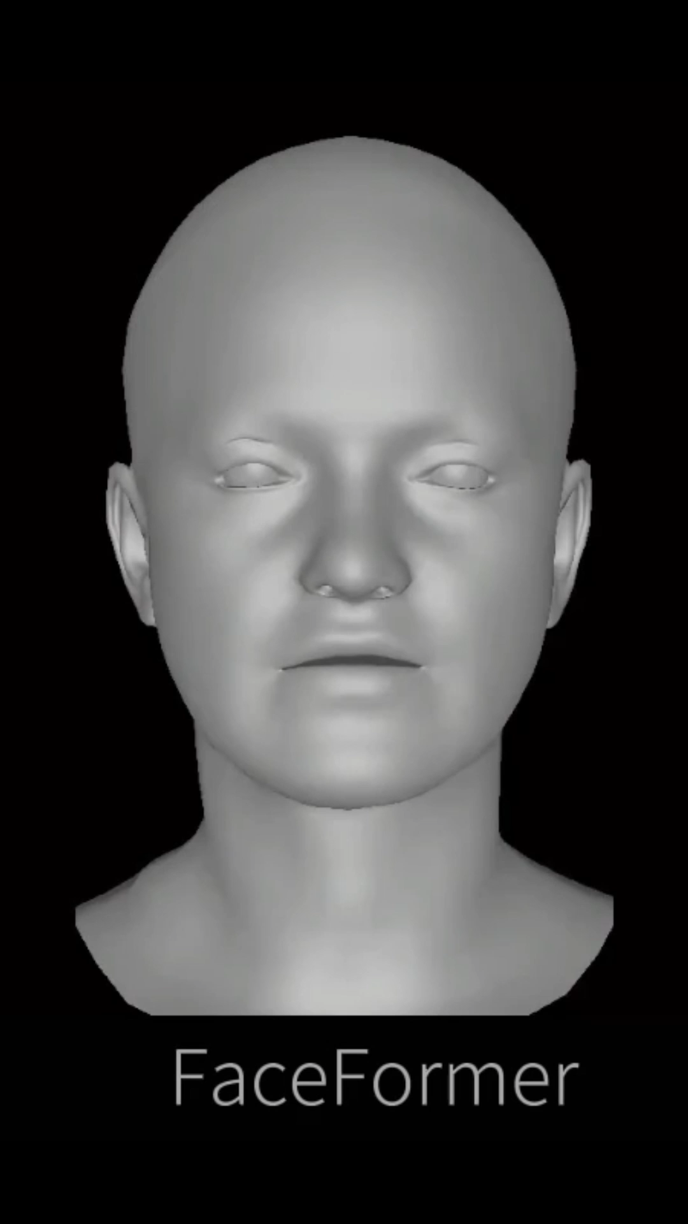
Related Works
Text-to-Body-Motion
Audio-to-Facial-Motion
HMDM
“A person walks forward, bends down to pick something up off the ground”
SMF
“He walks forward and then turns around fast and walks back”
FaceFormer
Notes:
- During search -> HMDM & SMF
- skeletal, full-body motion from text description using diffusion
- Started with adapting HMDM to facial domain, failed to obtain results
- SMF was not available, released in June this year
- Instead chose to follow FaceFormer, yielded good results in facial domain

Slide 5
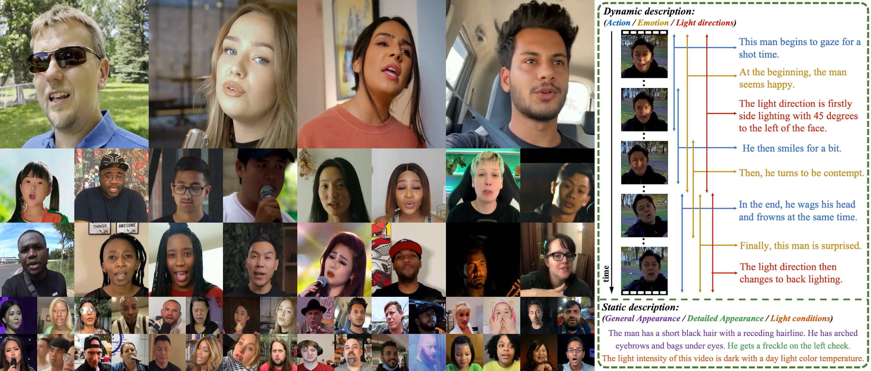
Dataset Creation
https://celebv-text.github.io/
Notes:
- dataset of vital importance
- no dataset matched our expectations, we decided to create our own
- Chose CelebV-Text as basis
- Large amount of in-the-wild facial videos with descriptions generated through PCFG

Slide 6
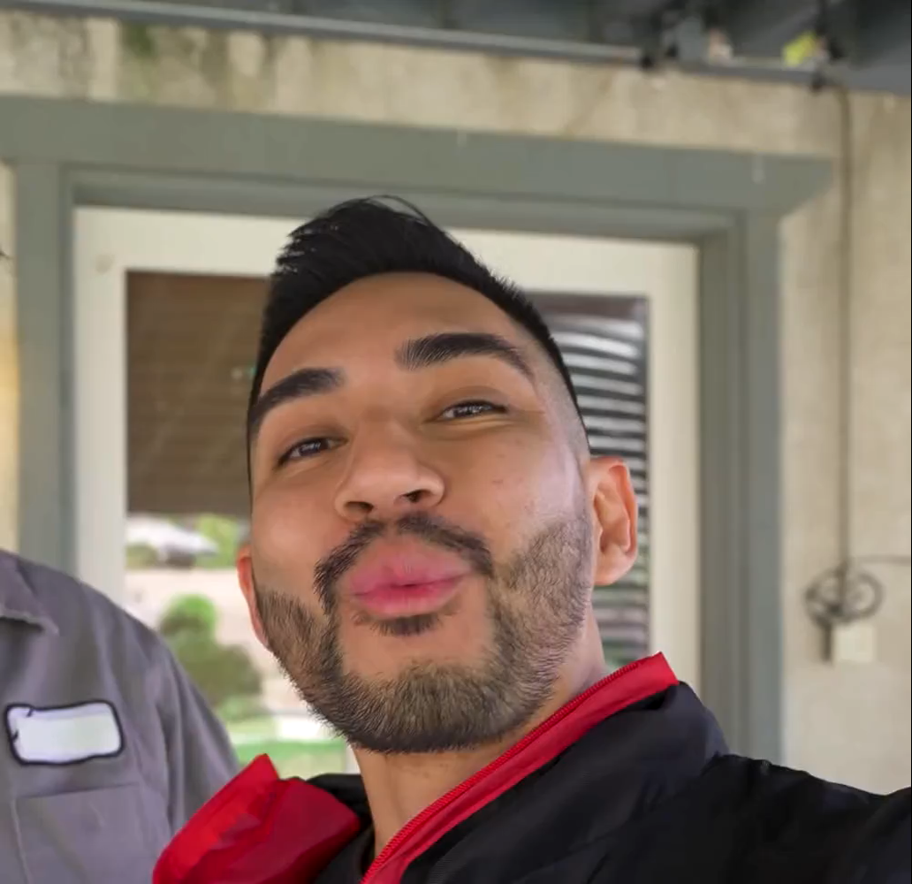
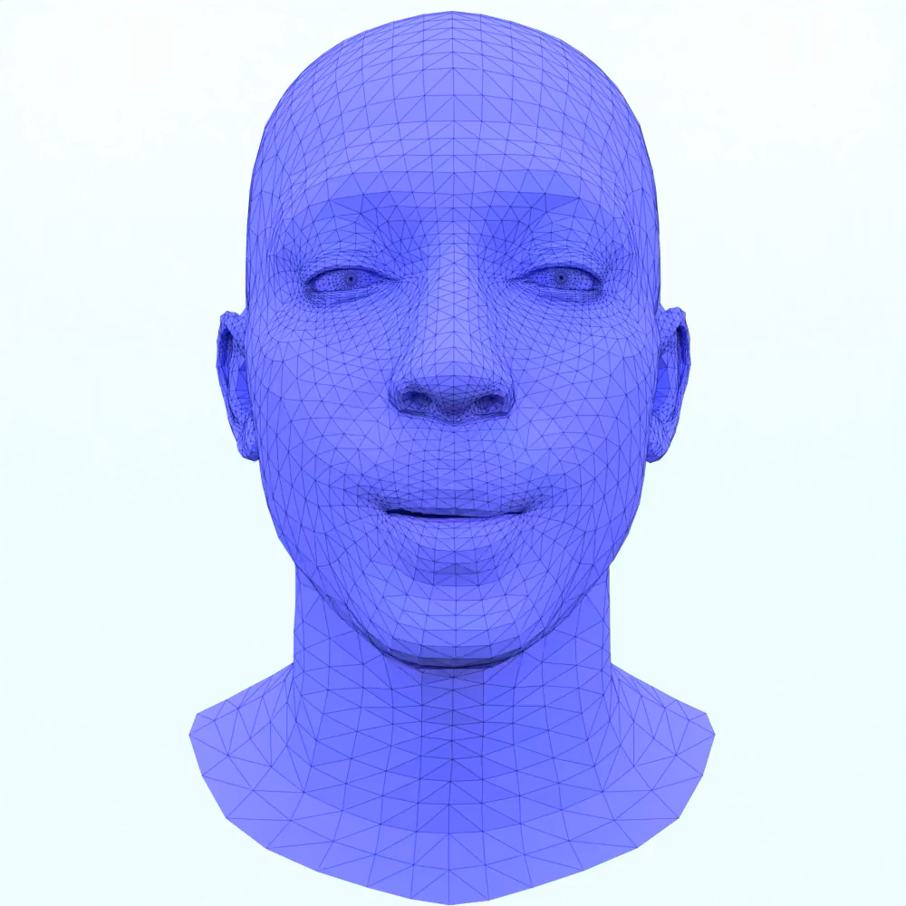
Dataset Creation
Dataset
Creation
To begin with, the man talks for a short time
Notes:
- New requirement: 3D tracking and reconstruction to obtain 3D animation

Slide 7
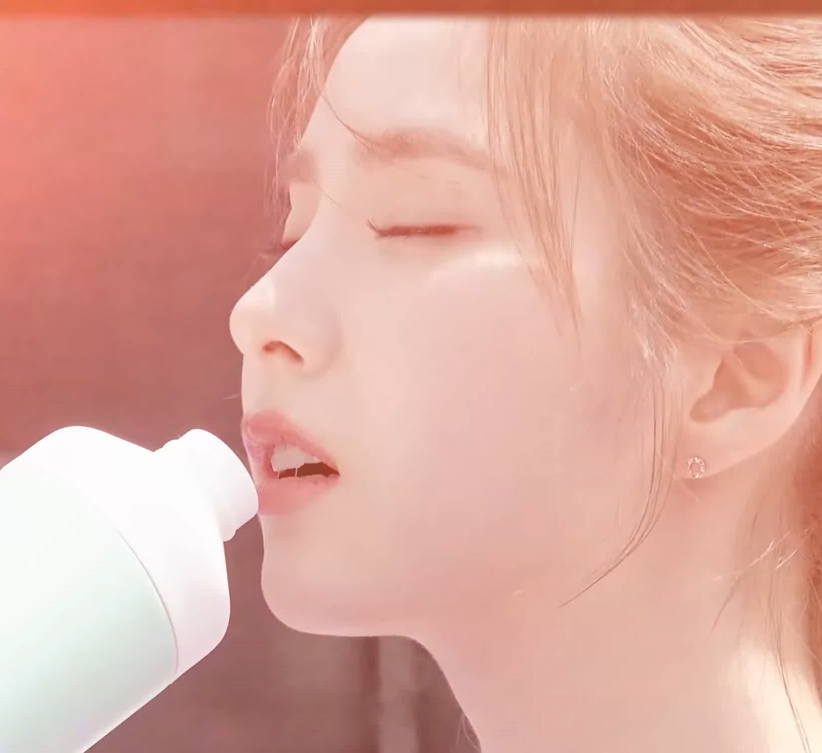
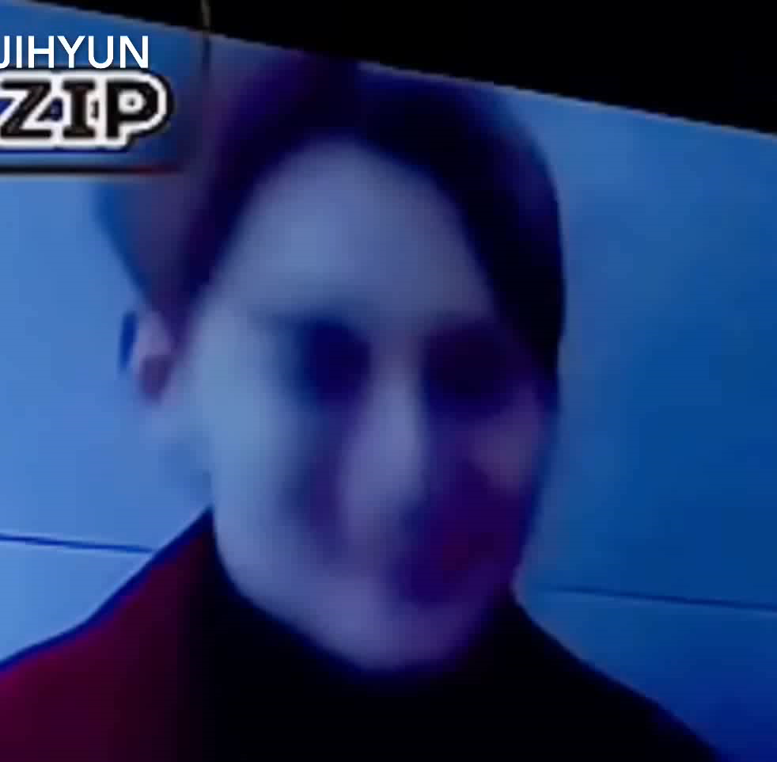
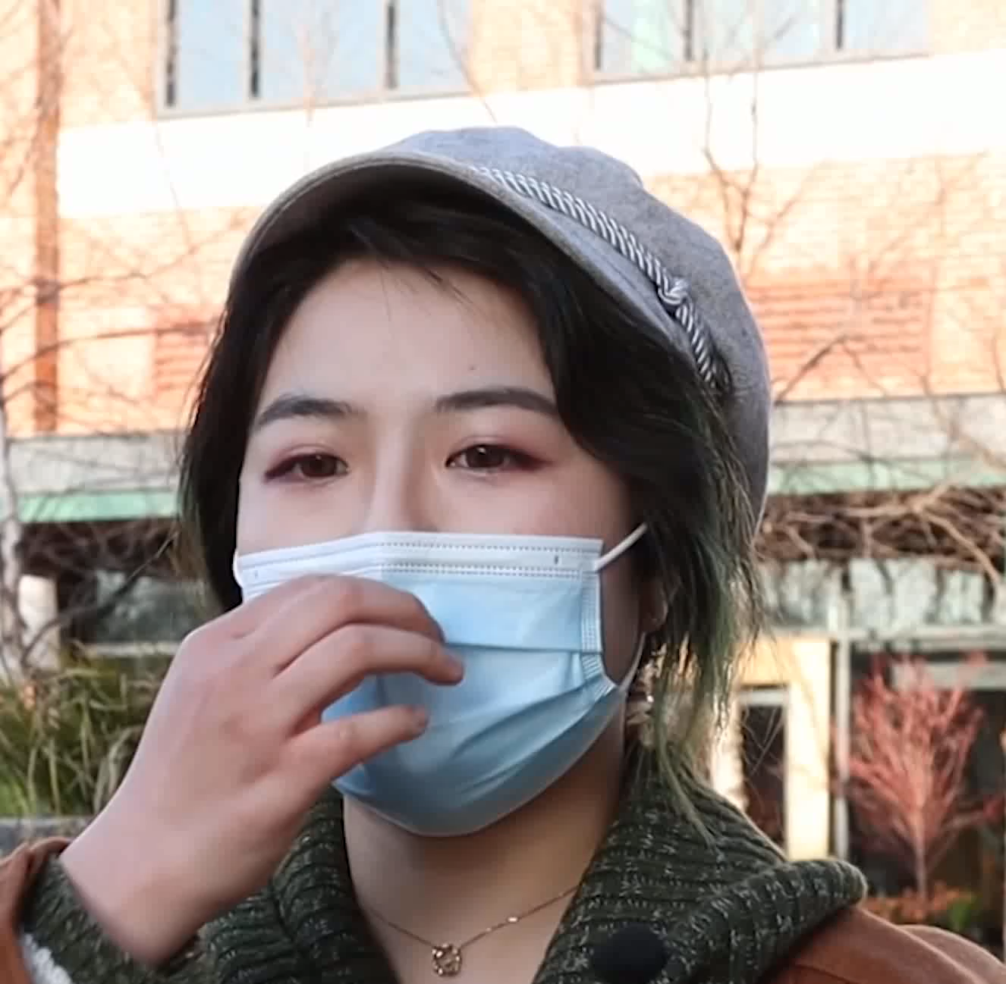
Dataset Creation
Turned
Bad Angle
Facial Occlusion
Notes:
- Not all videos usable
- first video: turned, half of the face not visible
- second video: recorded from a bad angle
- third video: mouth region is hidden

Slide 8
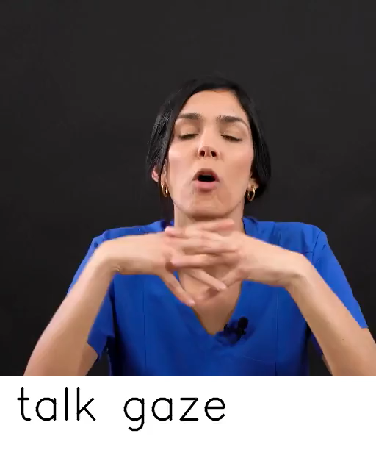
Dataset Creation
Original: To begin with, the woman talks meanwhile gazing for a short time, then she frowns for a long time, in the end she blinks for a long time
New: To begin with, the woman talks and gazes for a short time, then she talks, gazes and frowns for a short time, in the end she talks, gazes and blinks for a long time
Notes:
- Another problem: “Textual Alignment Problem”
- Lets demonstrate it:
- Description
- Suggest talk, gaze -> frown -> bling
- lets see the video
- talk, gaze persistent throughout the video
- solution: modify PCFG to consider all assigned labels, not only added ones
- new description

Slide 9
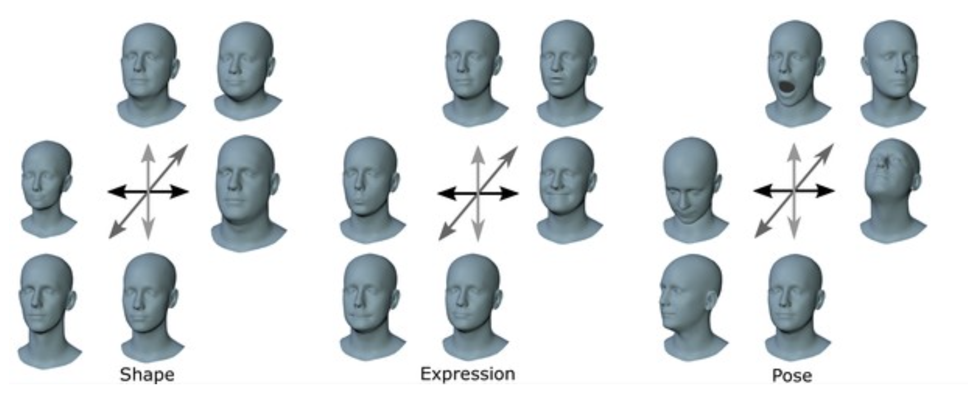
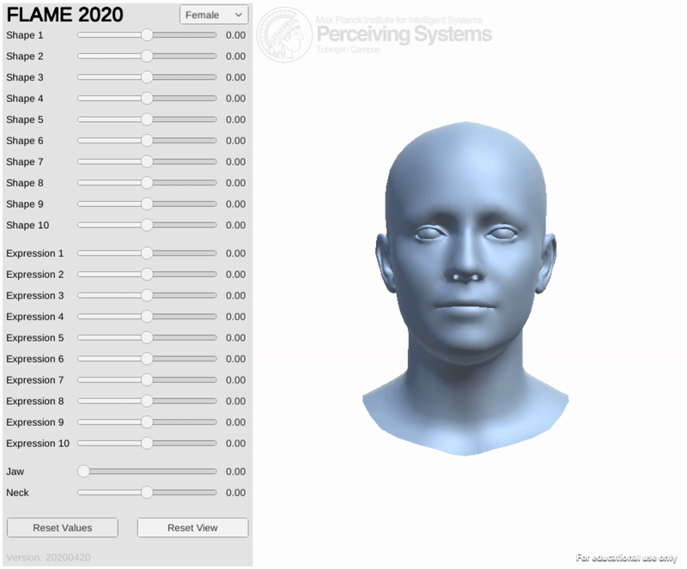
Data Representation
https://flame.is.tue.mpg.de/
Notes:
- Initially tried to work with the FLAME representation (you can see here)
- Model could not handle the additional abstraction correctly
- Decided to work directly with vertices (similar to FaceFormer)

Slide 10
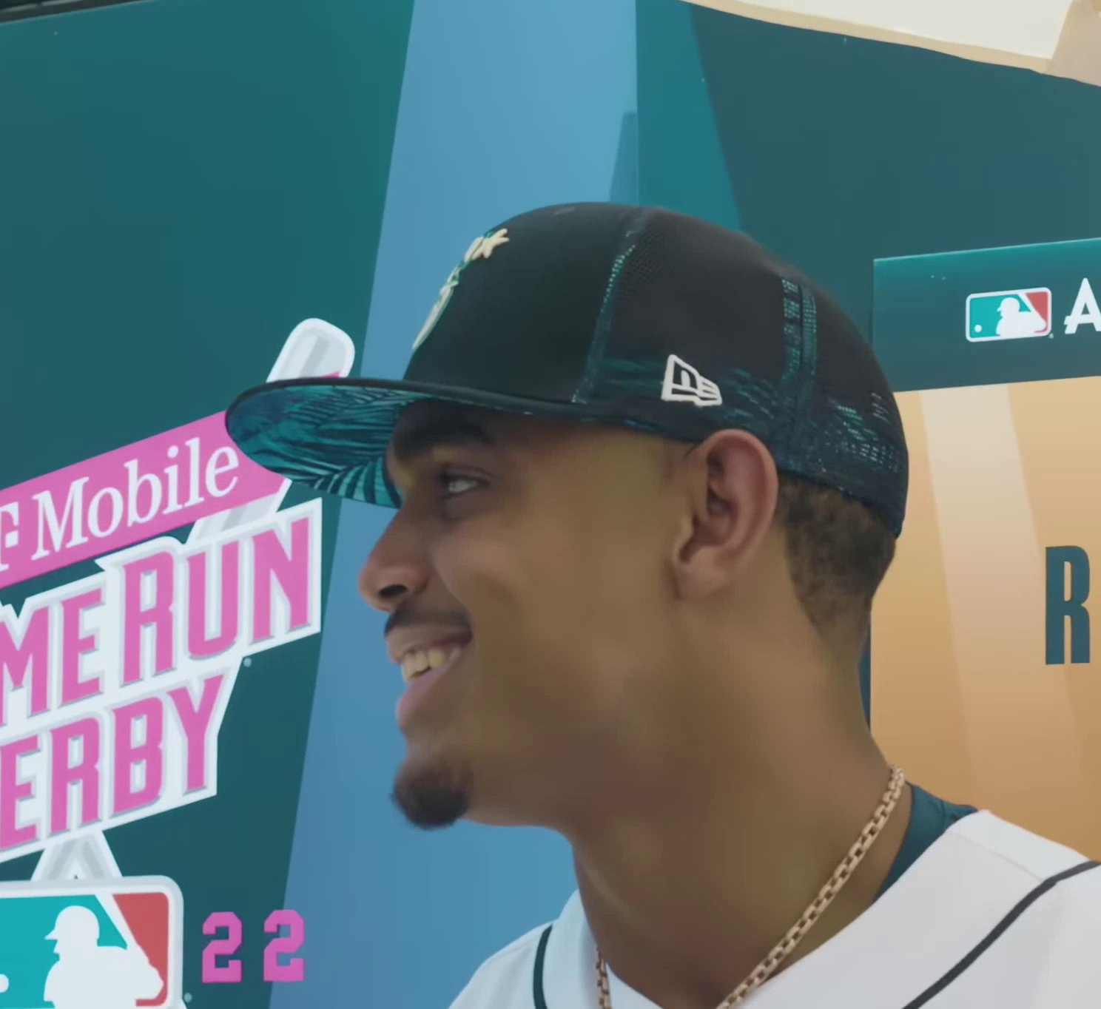
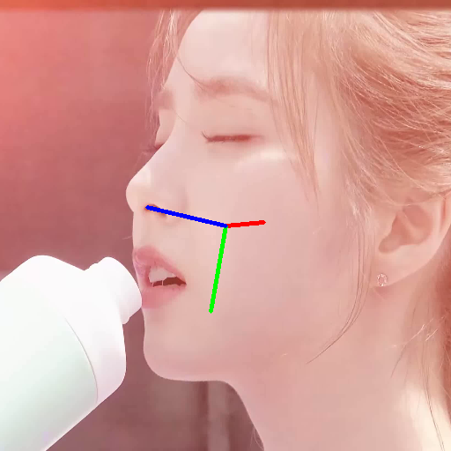
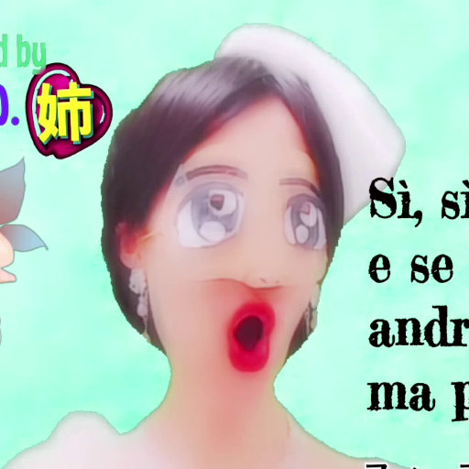

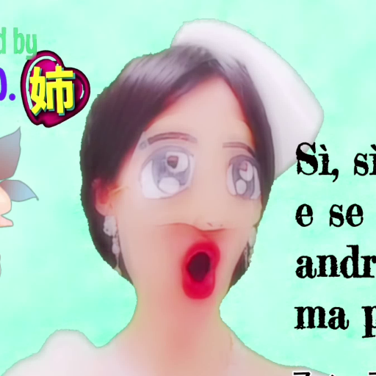
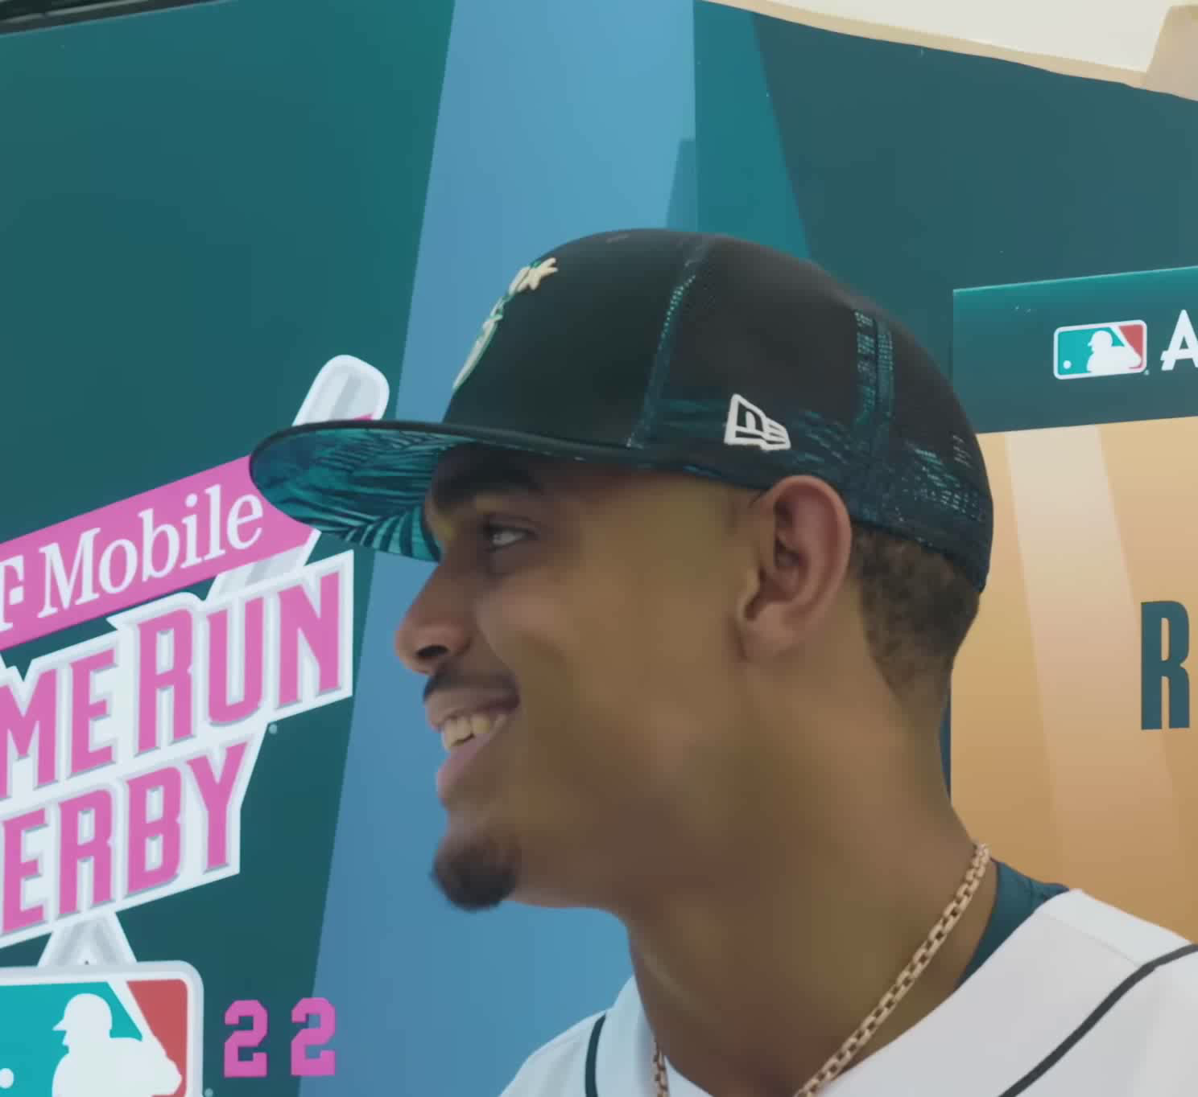
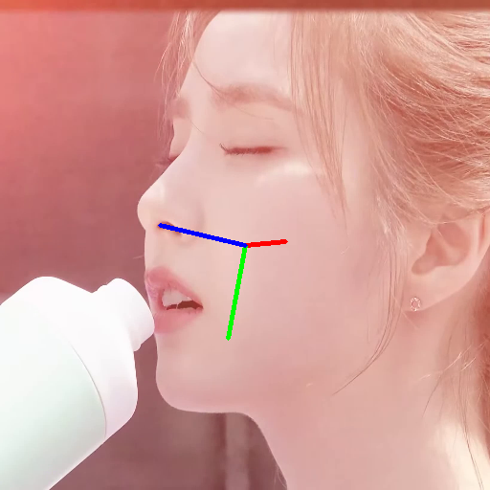

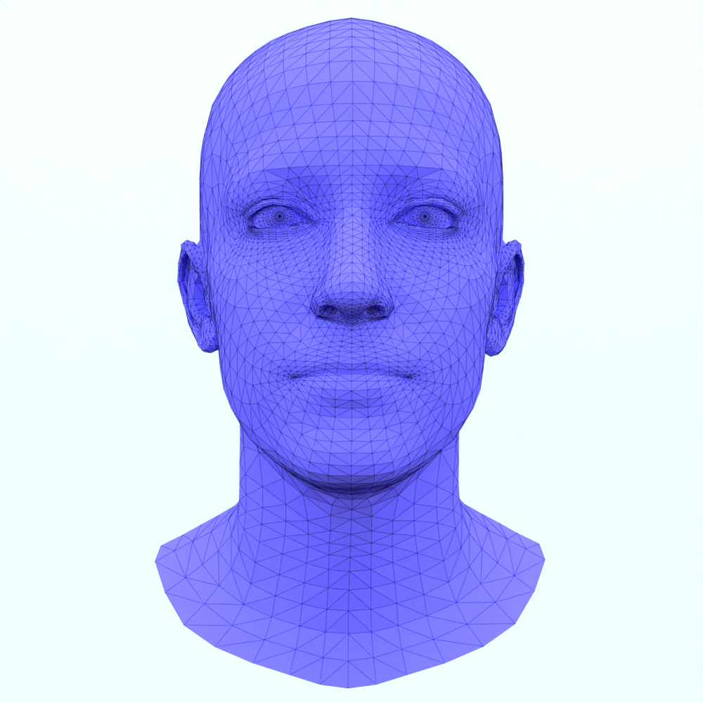
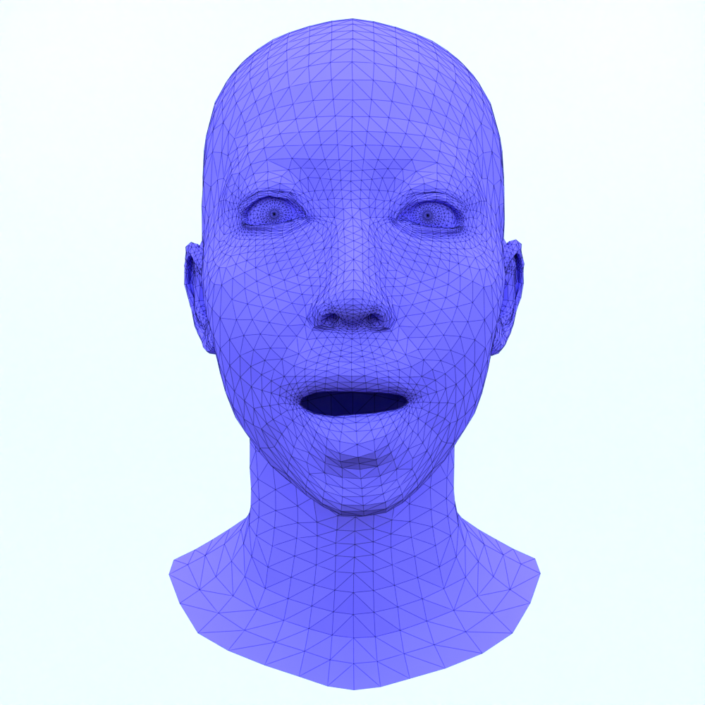
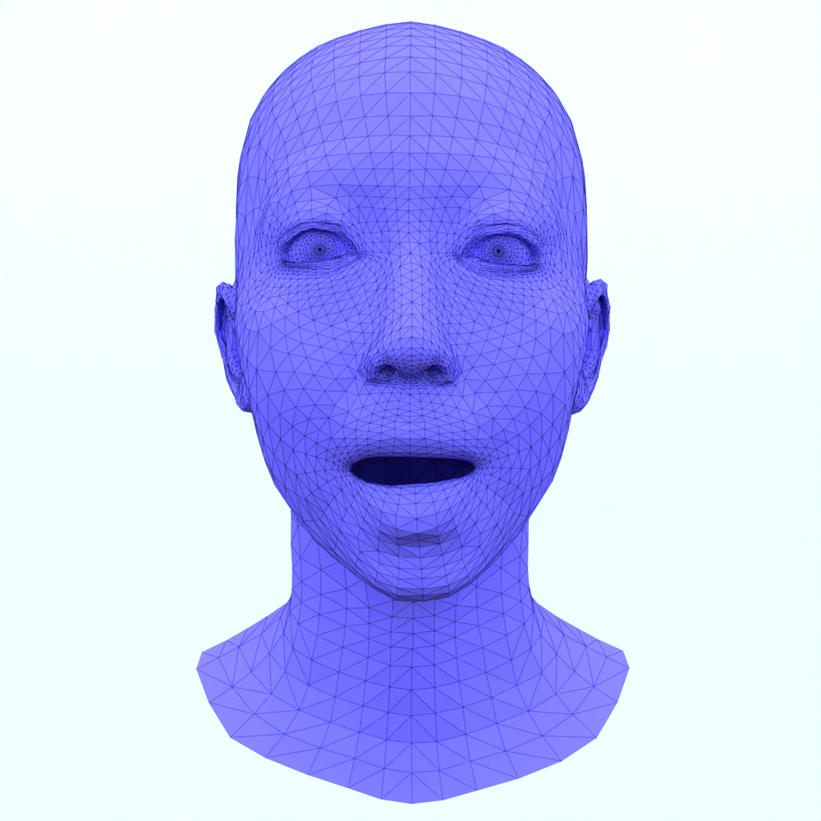
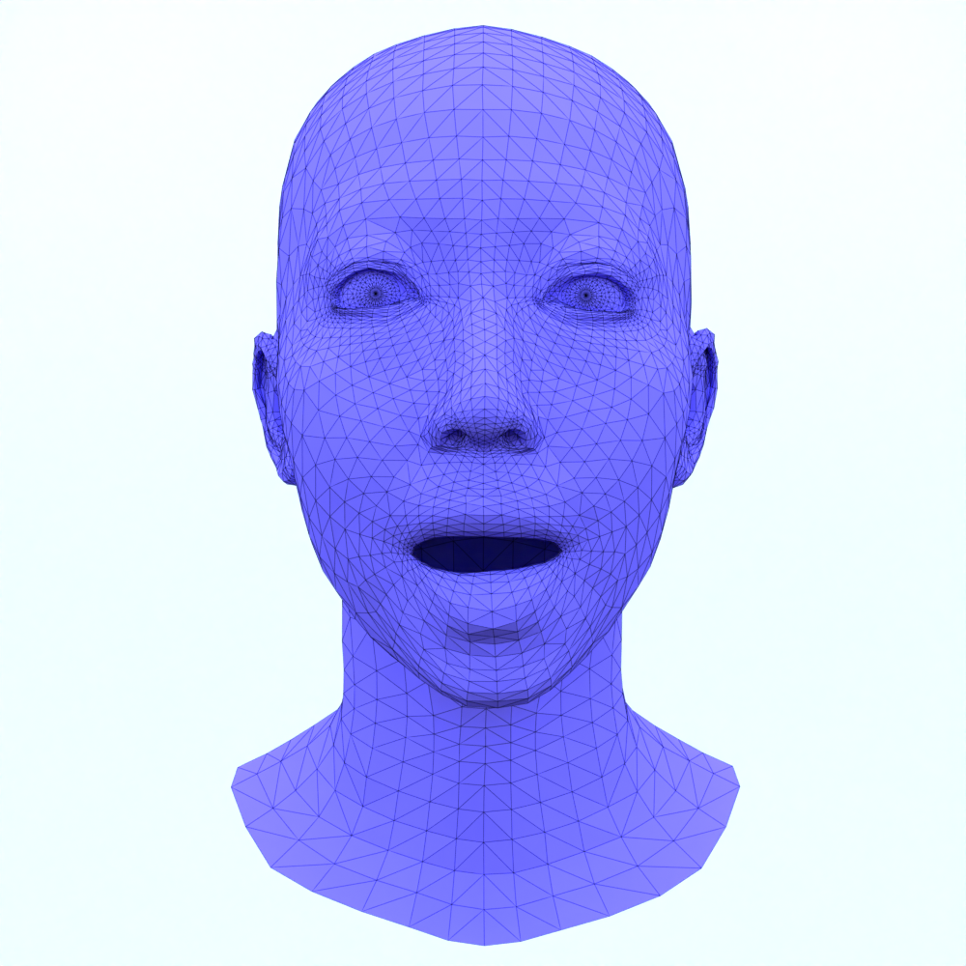
Dataset Pipeline
Turn
Look around
Head wagging
Shake head
Too high rotation
Reconstruction Error
Video Metadata
MICA
URL, Duration, Crop
Description
Download
This woman begins to sing and turn for a short time
Shape Reconstruction
Metrical Tracker
Attribute Assignment
Sing, Turn
Annotation Script
New Annotations
Notes:
- dataset creation pipeline now as follows:
- start with provided information from CelebVText, Video Metadata, Descriptions and timestamped attributes
- 1. Discard any videos with attributes suggesting a turning motion
- 2. Download the rest
- 3. Perform 6D rotational estimation & discard too turned ones
- 4. Obtain Shape Template using MICA from keyframe
- 5. Use shape template + frames to reconstruction entire animation with consistent shape
- Still some failures: discard

Slide 11
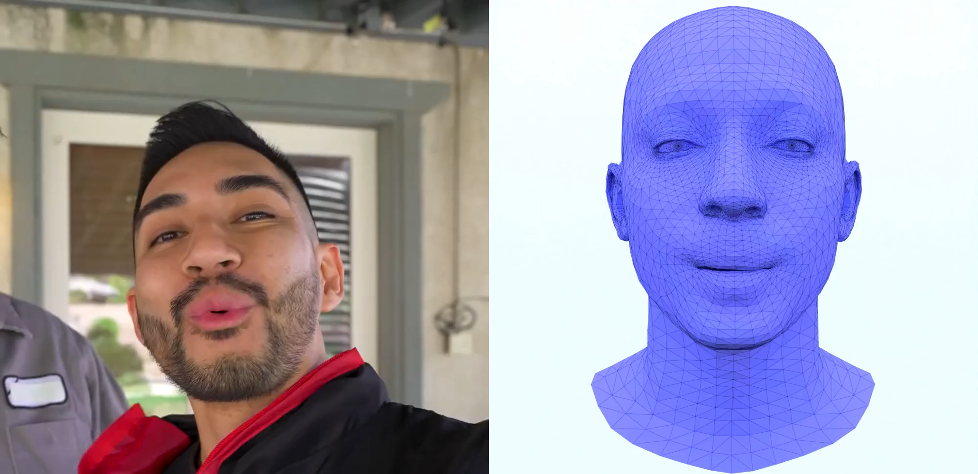
Dataset Examples
Notes:
Examples

Slide 12
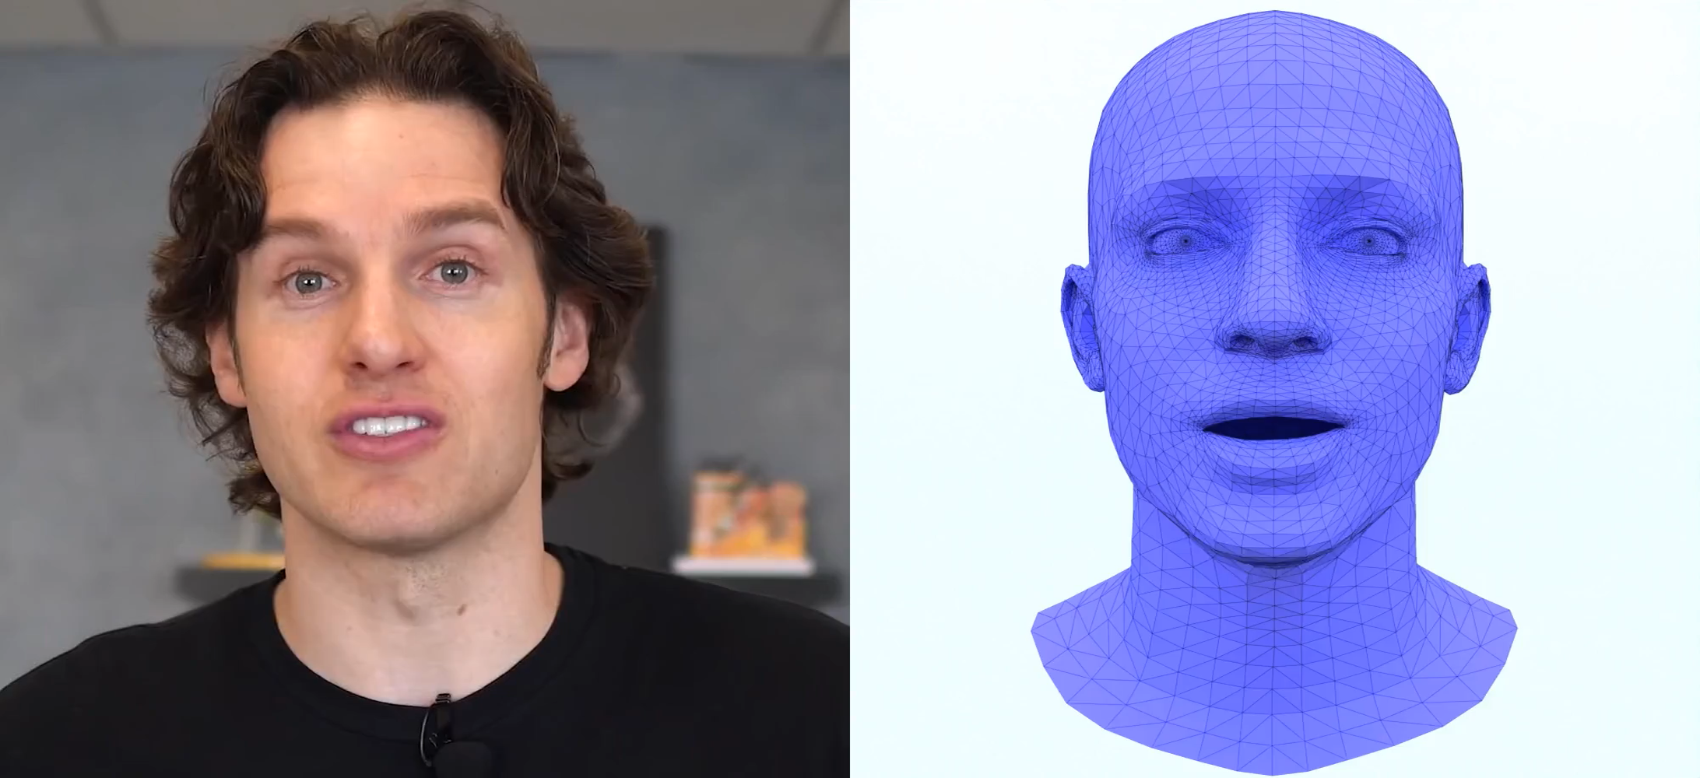
Dataset Examples
Notes:
Examples

Slide 13
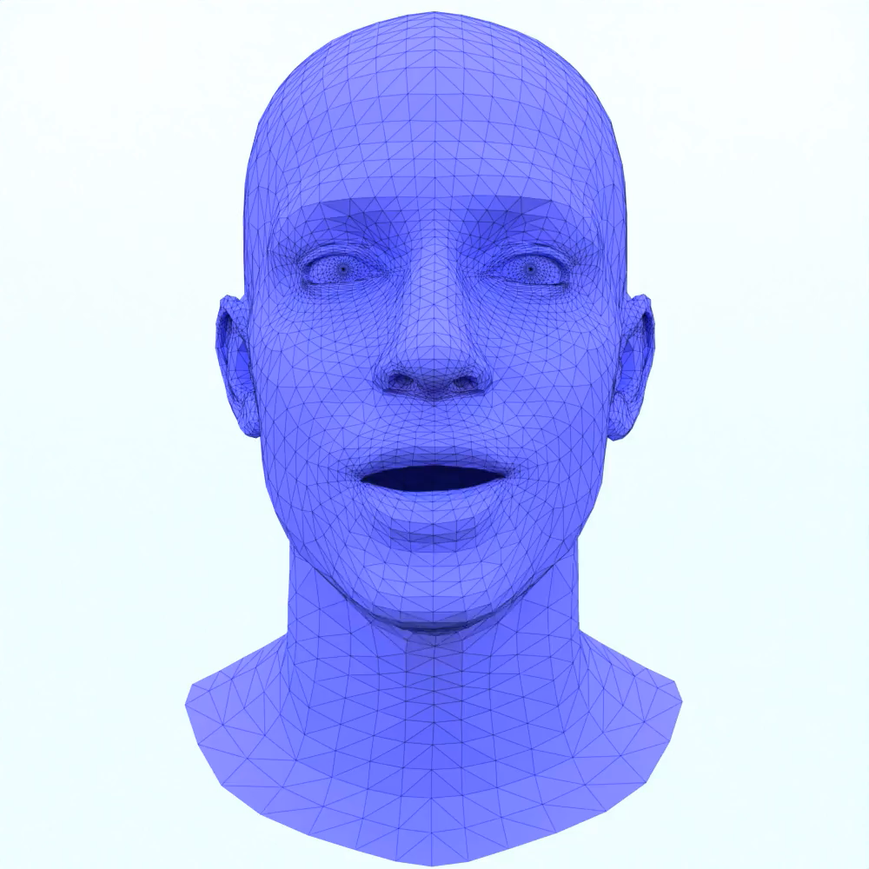
Method
Sequential
Model
A person is talking
Natural Language
Non-Deterministic
Notes:
- go over to our model
- from a text description
- generate facial animations (multiple with the same prompt)
- requirements: handle Natural language, non-deterministic, sequential model

Slide 14
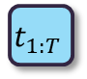
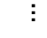
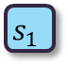

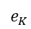

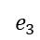

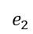
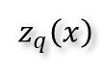
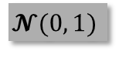
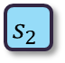
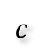
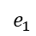
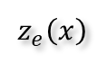
Method
$$t_{1:T}$$
Linear Projection
$$s_{1}$$
$$s_{2}$$
$$s_{3}$$
$$…$$
$$s_{T}$$
Add temporal dimension
Encoder
reshape
Decoder
$$z_{q}\left(x\right)$$
$$c$$
$$e_{1}$$
Entry from codebook
$$e_{2}$$
$$e_{3}$$
Codebook
Quantizer
Conditional VQVAE
$$…$$
argmin
$$e_{K}$$
Calculate distance
$$z_{e}\left(x\right)$$
Encoder
CLIP
Description &
Sample unique information
“A person is smiling.”
$$𝓝(0, 1)$$
Notes:
- Follow usual Encoder Decoder architecture
- Encoder: provide sequential guidance and follows a cVQVAE approach
- input: Description + Sample Unique information
- description to clip -> Natural Language handling
- passed to codebook -> usual quantization approach to obtain nearest entry
- combined with the sample unique information before passed to cVQVAE decoder
- reshape to add temporal dimension + project to Transformer decoder dimension

Slide 15
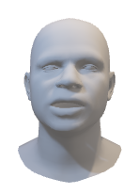
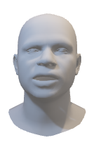

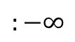
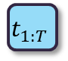
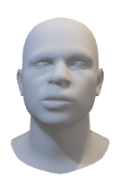
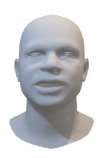
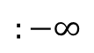
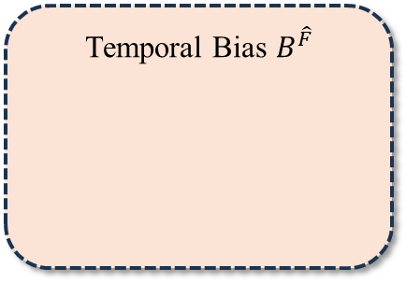






Method
Prediction
Alignment Bias $B^{A}$
Decoder
$${\hat{y}}_{1},…,{\hat{y}}_{T}$$
Memory
0
 | 0
 |  | 0
 |  |  | 0
 |  |  |  | 0
$$:−∞$$
$$t_{1:T}$$
Motion Decoder
Feed Forward
Biased Cross-Modal MH Attention
Transformer
Biased Causal MH Self-Attention
Temporal Bias $B^{\hat{F}}$
Periodic Positional Encoding
0
-1 | 0
-2 | -1 | 0
-3 | -2 | -1 | 0
-4 | -3 | -2 | -1 | 0
$$:−∞$$
Motion Encoder
Ground-Truth Mesh
$$y_{0},…,y_{T−1}$$
Notes:
- Trans Dec: inspired by FaceFormer project (as it demonstrated potential for high quality facial animations)
- trained in a teacher forcing way -> input: ground truth meshes from 0:T-1 + memory of Encoder
- reduce dimensionality of meshes using linear projection
- apply PPE as suggested by FaceFormer
- MH-Self-Attention + temporal bias to increase attention to more recent sequence elements
- MH-Cross-Attention with memory and Alignment bias, enforcing temporal guidance from memory
- Feed Forward. Completing the transformer
- Linear projection back to meshes to obtain predictions

Slide 16









Method
Linear Projection
$$s_{1}$$
$$s_{2}$$
$$s_{3}$$
$$…$$
$$s_{T}$$
$${\hat{y}}_{1},…,{\hat{y}}_{T}$$
Encoder
reshape
Motion Decoder
Decoder
$$t_{1:T}$$
Decoder
$$z_{q}\left(x\right)$$
$$c$$
Feed Forward
$$e_{1}$$
Entry from codebook
Biased Cross-Modal MH Attention
Alignment Bias $B^{A}$
$$e_{2}$$
$$e_{3}$$
Codebook
Quantizer
$$…$$
argmin
Biased Causal MH Self-Attention
Temporal Bias $B^{\hat{F}}$
$$e_{K}$$
Calculate distance
Periodic Positional Encoding
$$z_{e}\left(x\right)$$
Encoder
Motion Encoder
CLIP
$$y_{0},…,y_{T−1}$$
“A person is smiling.”
$$𝓝(0, 1)$$
Notes:
- Both combined

Slide 17

Baseline Comparison
HMDM
SMF
Ours
A person is kissing
Notes:
- Some results
- compare with HMDM and SMF, both adapted to facial domain
- HMDM: no movement at all, generates most average face of the dataset
- SMF: generates motion, but does not match description
- Ours: Good kissing motion

Slide 18

Baseline Comparison
HMDM
SMF
Ours
A person is talking
Notes:
- Not all output is so good
- fails to produce a good talking animation
- most likely: wide range of animations classified as “talking” in the dataset

Slide 19

Baseline Comparison
HMDM
SMF
Ours
A person is yawning
Notes:
- SMF produces jittering motion, not yawning
- Ours: supressed yawning

Slide 20

Qualitative Analysis
A person is crying
A person is weeping
Notes:
- Higher resolution
- Crying in terror
- Weeping weakly

Slide 21
Qualitative Analysis
A person is sneering
A person is kissing
Notes:
- Looking sneeringly
- Making a kissing face (to emphasize the good lip movement)

Slide 22

Diversity
A person is drinking
Notes:
drinking

Slide 23

Diversity
A person is yawning
Notes:
yawning

Slide 24

Quantitative Analysis
Bold: best result
Underlined: second best
Method | MAE $↓$ | RMSE $↓$ | Diversity $→$
Real (Dataset) | $$−$$ | $$−$$ | $${10.8744}^{±0483}$$
HMDM (adapted) | $${0.6999}^{±.0000}$$ | $${0.9006}^{±.0000}$$ | $${0.0000}^{±.0000}$$
SMF (adapted) | $${0.9272}^{±0052}$$ | $$\underline{{1.1773}^{±.0060}}$$ | $${9.2109}^{±.0620}$$
Ours | $$\underline{{0.9239}^{±.0067}}$$ | $${1.2013}^{±.0083}$$ | $$\underline{{7.5996}^{±.1755}}$$
Notes:
- quantitative performance
- No established metrics, decided to use MAE, RMSE and diversity
- HMDM best in MAE, RMSE but no diversity -> no movement -> most average face
- SMF best in terms of diversity but as seen before, often does not match description

Slide 25

Ablation Study
Bold: best result
Method | MAE $↓$ | RMSE $↓$ | Diversity $→$
Real (Dataset) | $$−$$ | $$−$$ | $${10.8744}^{±0483}$$
Autoregressive | $${0.7003}^{±.0000}$$ | $${0.9008}^{±.0000}$$ | $${0.0431}^{±.0004}$$
Style | $${0.9066}^{±.0047}$$ | $${1.1673}^{±.0054}$$ | $${6.7660 }^{±.1065}$$
Ours (Full) | $${0.9239}^{±.0067}$$ | $${1.2013}^{±.0083}$$ | $${7.5996}^{±.1755}$$
Notes:
- how different aspects of our model impact quantitative performance as part of ablation study
- impact of training using autoregressive training instead of teacher-forcing
- Style conditioning similar to FaceFormer

Slide 26

Ablation Study
Bold: best result
$$D_{emb}$$ | $$N_{emb}$$ | MAE $↓$ | RMSE $↓$ | Diversity $→$
Real (Dataset) |  | $$−$$ | $$−$$ | $${10.8744}^{±.0483}$$
$$256$$ | $$256$$ | $${0.8872}^{±.0046}$$ | $${1.1479}^{±.0051}$$ | $${7.1254}^{±.1026}$$
$$256$$ | $$64$$ | $${0.9613}^{±.0052}$$ | $${1.2324}^{±.0064}$$ | $${6.8904}^{±.1132}$$
$$128$$ | $$128$$ | $${0.8861}^{±.0040}$$ | $${1.1376}^{±.0048}$$ | $${6.8693}^{±.1042}$$
$$512$$ | $$128$$ | $${0.8830}^{±.0053}$$ | $${1.1338}^{±.0064}$$ | $${6.4074}^{±.1032}$$
Ours (Full) |  | $${0.9239}^{±.0067}$$ | $${1.2013}^{±.0083}$$ | $${7.5996}^{±.1755}$$
Notes:
- Impact of Codebook dimensions
- Smaller Codebook: Fails to achieve a good diversity rating
- Larger Codebook: Capable of overfitting too much

Slide 27
Challenges
Dataset Quality
Sometimes problems with the tracking accuracy
Unbalanced distribution of expressions
Textual descriptions varies very little
Model Diversity
Model could reach the desired expression, but remained mostly static thereafter
Notes:
- Problems with the dataset
- tracking accuracy not ideal as many videos were still of bad quality
- labels sometimes not finely enough grained (especially talking), cannot be solved by the PCFG
- But what could be solved by the PCFG: still only a small fraction of spoken language “covered”
- Problems with the model:
- mostly capable of reaching the desired expression
- but mainly static afterwards

Slide 28

Future Work
Dataset:
Explore FaMoS dataset
Create new Dataset with better descriptions
Model:
Explore SMF Diffusion Approach
FaMoS Dataset
https://tempeh.is.tue.mpg.de/
Notes:
- Solutions:
- Find better dataset
- use FaMoS -> provides action attributes with motion captured expressions, increasing quality manifold
- Create new dataset
- Model:
- Explore SMF diffusion approach in greater detail,
- not possible as part of this thesis as it was published in June this year

Slide 29

Human Motion Diffusion Model

Slide 30

StableMoFusion (SMF)

Slide 31

FaceFormer

Slide 32
Metrics
Qualitative
Textual correctness
Sequential Coherence
Qualitative Comparison
Quantitative
MAE (to GT sample of Test split)
RMSE (to GT sample of Test split)
Diversity (compared to Test Split)

